Slide 1
Mobile Security Framework (MobSF)
A security research platform for mobile applications in Android, iOS and Windows Mobile.
1905077- Md. Nafiu Rahman
1905084- Wasif Jalal

Slide 2

Mobile Security Framework (MobSF) is a security research platform for mobile applications in Android, iOS and Windows Mobile. MobSF can be used for a variety of use cases such as mobile application security, penetration testing, malware analysis, and privacy analysis.

Slide 3
Installation of MobSF
Install Docker on your computer from this link https://www.docker.com/products/docker-desktop/
On your terminal run -
docker pull opensecurity/mobile-security-framework-mobsf:latest
Once the image is downloaded, you can run MobSF in a Docker container using the following command:
docker run -it --rm -p 8000:8000 opensecurity/mobile-security-framework-mobsf

Slide 4
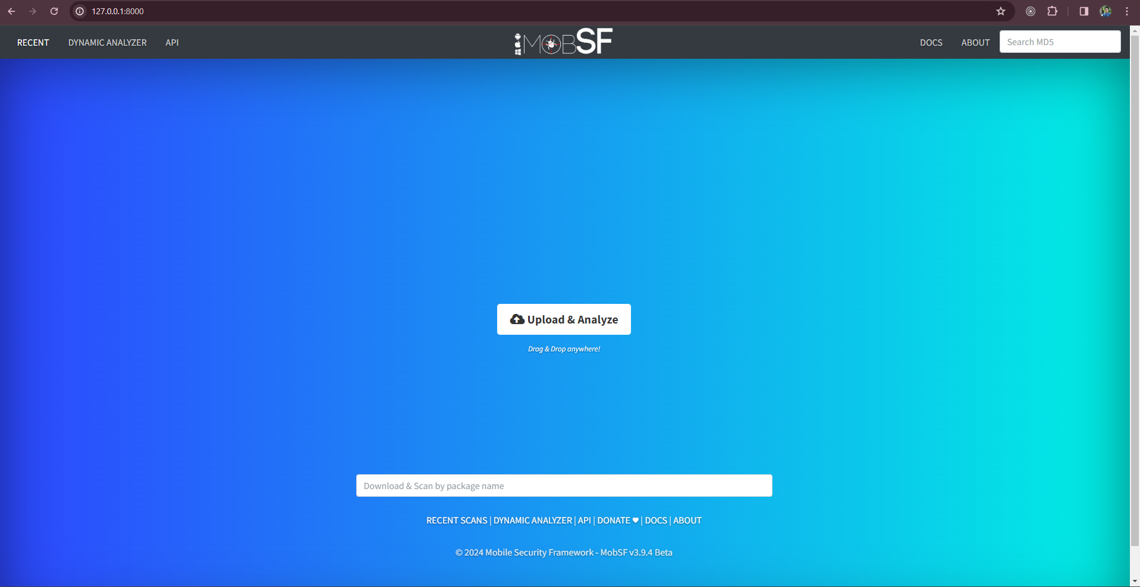
WebView of MobSF

Slide 5
Static Analysis:
MOBSF's static analysis feature examines the source code of mobile applications to uncover security vulnerabilities such as hardcoded credentials or sensitive data exposure, aiding developers in preemptively addressing potential threats. By automating the scanning process and generating detailed reports, MOBSF streamlines the identification and mitigation of security risks in mobile applications

Slide 6
Scan Options
MobSF’s ”Scan Options” grant users dynamic control. ”Rescan” updates security assessments based on new data or modifications. ”Manage Suppressions” aids in handling false positives or ignored findings. ”Start Dynamic Analysis” initiates runtime assessment, revealing behavioral vulnerabilities. Users can also download/view source code and inspect AndroidManifest.xml.

Slide 7
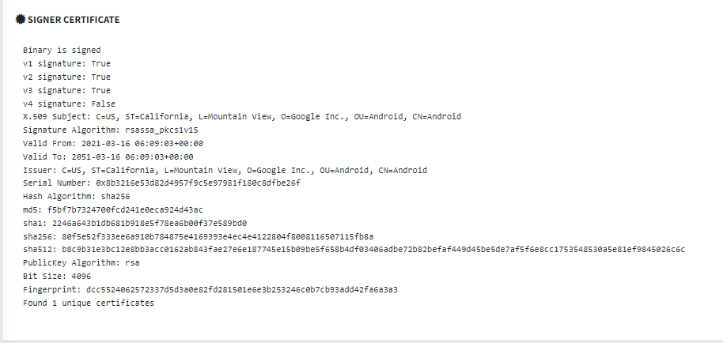
Signer’s certificate
"MOBSF's 'Signer Certificate' feature ensures APK legitimacy and dependability by verifying the digital signature, confirming app provenance, and detecting tampering. Details like hashing and public key algorithms provide reassurance to users and developers about the app's integrity.

Slide 8
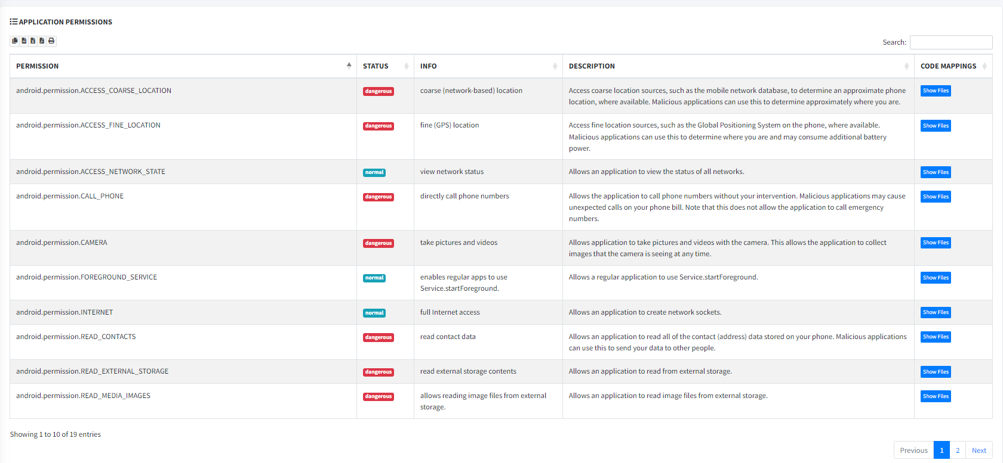
Permissions
MOBSF's 'Application Permissions' feature provides detailed insights into the permissions requested by an app, categorizing them as 'normal' or 'dangerous' and explaining their access levels. Users can view associated files and descriptions to understand permissions better, though it's important to note that 'dangerous' permissions may not always be malicious, depending on context.

Slide 9
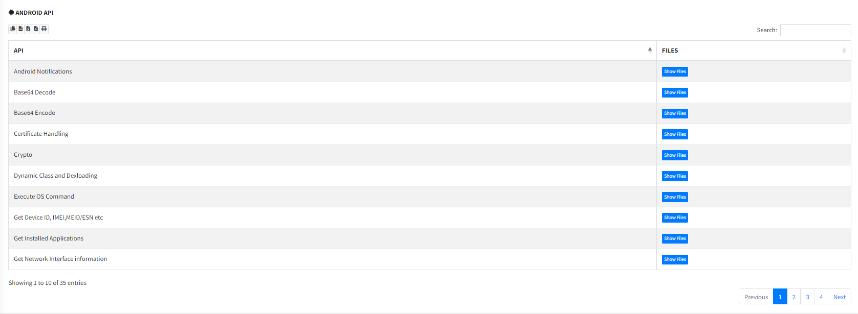
Android API
MOBSF's 'Android API' feature presents a clear summary of an app's interaction with the Android API through a table format, including columns for 'API' and 'Files.' It lists utilized Android functions alongside the code files employing each API, enhancing developers' understanding of app functionalities, dependencies, and security risks.

Slide 10
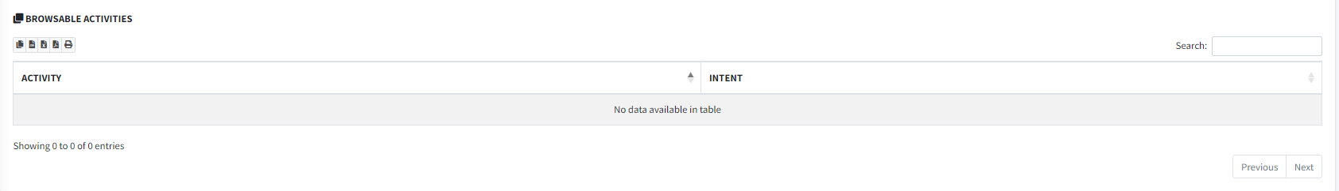
Browsable Activities
The 'Browsable Activities' section in MobSF meticulously outlines a mobile app's activities labeled as 'browsable,' which are accessible via specific schemes and serve as entry points for other apps or components. By identifying and highlighting these activities, MobSF offers critical insights into potential security vulnerabilities, as some browsable activities may inadvertently expose sensitive functionalities to unauthorized entities. This feature enables developers to proactively address security concerns, safeguard user data, and enhance the overall security of the app within a comprehensive assessment framework

Slide 11
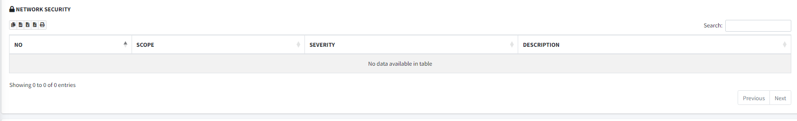
Security Analysis - Network Security:
MobSF’s ”Network Security” function is crucial for assessing network-related aspects of mobile apps. It organizes findings into ”High,” ”Warning,” and ”Info” categories, facilitating prioritization. Counts for each category offer insight into issue severity and prevalence. A detailed table presents key details including ”Scope,” ”Severity,” and ”Description,” aiding comprehension of network security threats by outlining context, impact, and explanation for developers and security experts

Slide 12
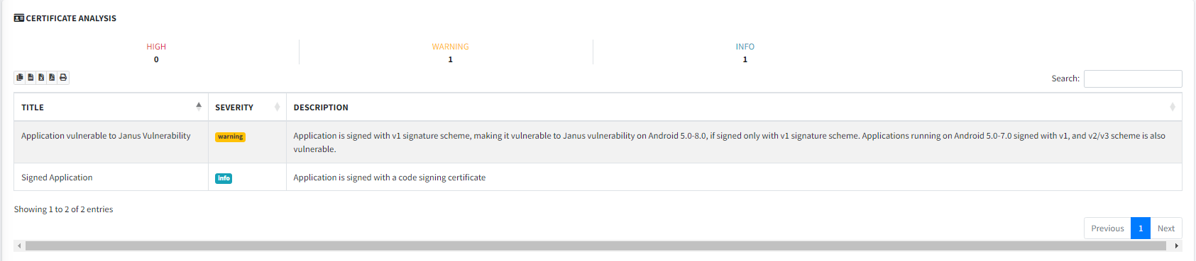
Security Analysis - Certificate Analysis
The ”Certificate Analysis” functionality in MobSF is a crucial aspect that assesses the security of certificates utilized by a mobile app. It categorizes findings into ”High,” ”Warning,” ”Info,” and ”Secure,” indicating the severity of certificate-related issues. Counts for each category offer a quick overview of prevalence and severity. Furthermore, a detailed table presents key details including ”Title,” ”Severity,” and ”Description,” aiding understanding of certificate vulnerabilities for developers and security professionals.

Slide 13
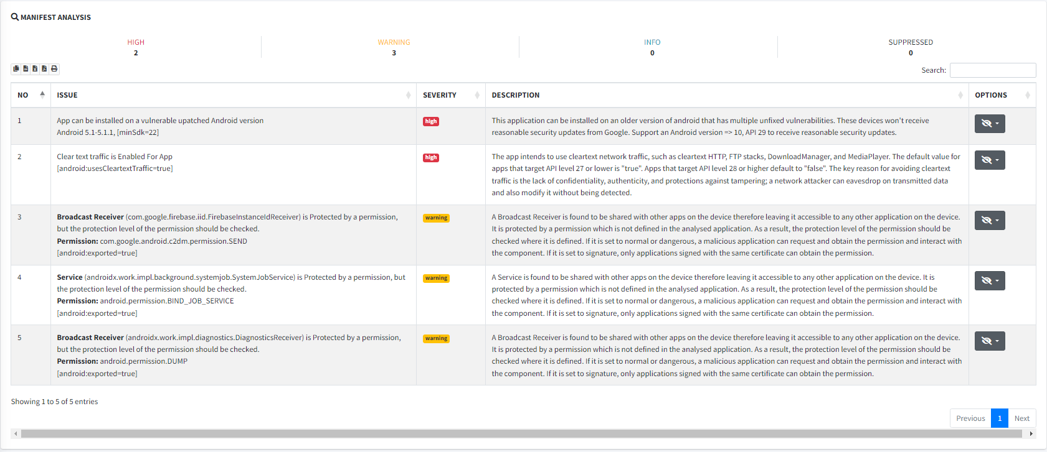
Security Analysis - Manifest Analysis
MobSF's 'Manifest Analysis' function assesses an app's security by categorizing findings into 'High,' 'Warning,' 'Info,' and 'Suppressed' for severity clarification. It offers a comprehensive table with key columns like 'Issue,' 'Severity,' 'Description,' and 'Options,' allowing users to efficiently resolve manifest-related vulnerabilities, including the option to suppress specific rules.

Slide 14
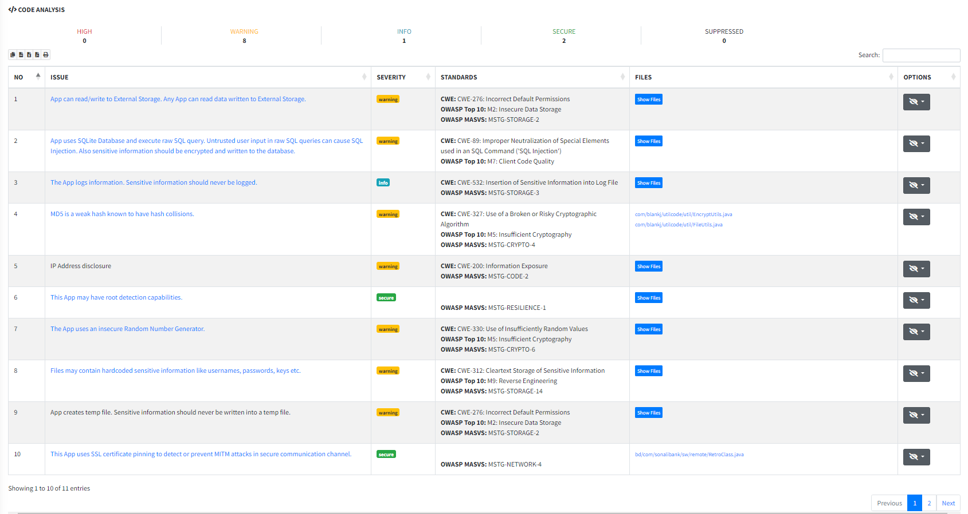
Code Analysis
MobSF's "Code Analysis" assesses an app's security by categorizing findings into levels like "High," "Warning," "Info," "Secure," and "Suppressed," based on standards like CW and OWASP. Counts for each category offer a quick summary of the severity and prevalence of code-related issues. A comprehensive table with key columns like "Issue," "Severity," "Standards," "Files," and "Options" enables effective prioritization and targeted resolution efforts, while the "Options" column allows users to suppress certain issues for flexibility in addressing vulnerabilities.

Slide 15
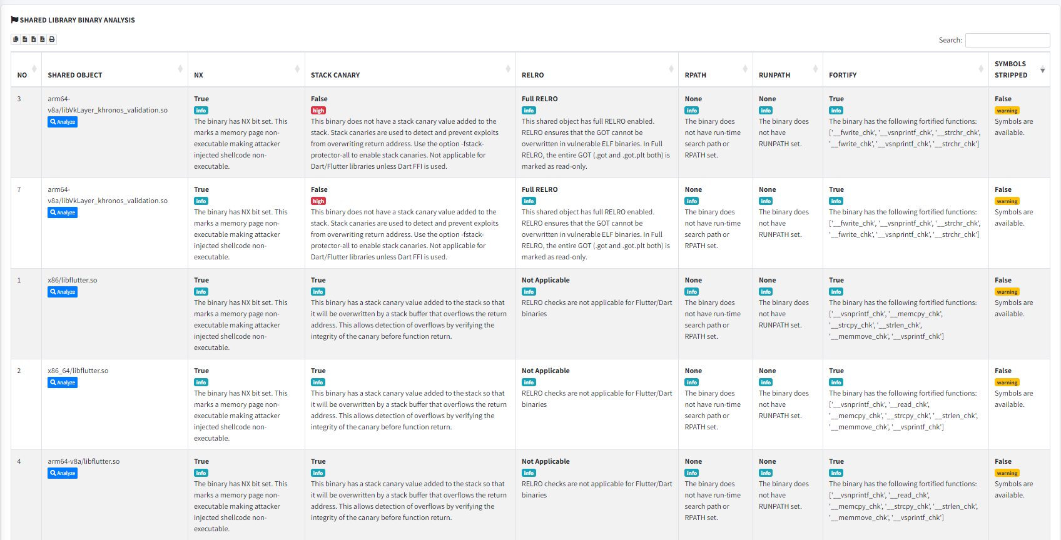
Security Analysis -Binary Analysis
Binary analysis is crucial if your code includes native files, ensuring they are properly compiled. MobSF's "Binary Analysis" evaluates app security through compiled binary files, presenting a detailed table with key attributes such as NX, Stack Canary, RELRO, RPATH, RUNPATH, FORTIFY, and SYMBOLS STRIPPED. These attributes indicate various security features and characteristics of the binary, including memory protection, exploit prevention, and reverse engineering difficulty, aiding developers in understanding and enhancing the app's security posture.

Slide 16
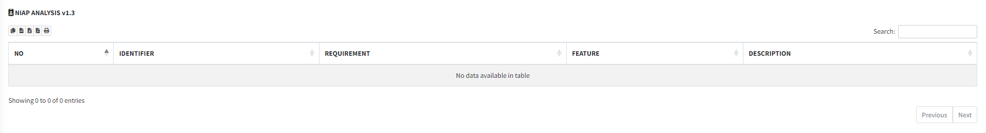
Security Analysis - NIAP Analysis
The National Information Assurance Partnership (NIAP) oversees certification of IT products to meet Common Criteria standards. MobSF's feature presents a table with columns like "Identifier," "Requirement," "Feature," and "Description," aiding users in understanding how the app meets NIAP standards through unique codes, outlined requirements, aligned features, and additional context provided in descriptions.

Slide 17
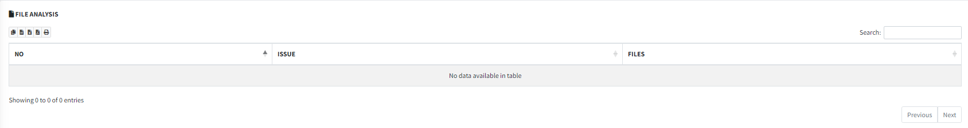
Security Analysis - File Analysis
This section redacts sensitive files, such as accidentally uploaded private keys. In the "Issue" column, it describes vulnerabilities or discrepancies detected within the application's files concisely. The "Files" column lists the individual files associated with each issue, aiding in locating and resolving problems effectively.

Slide 18
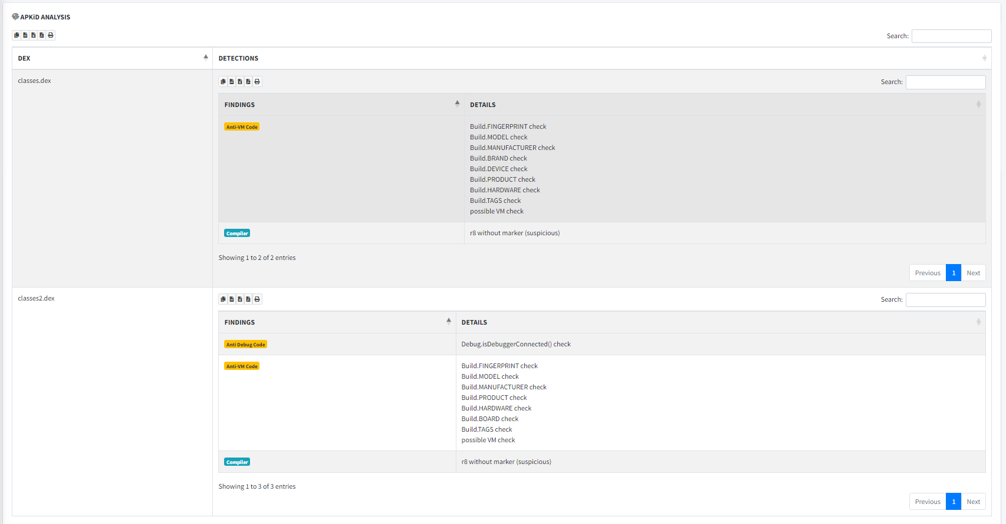
Malware Analysis - APKid Analysis
The Apk id analysis feature examines the APK's dex files, revealing behavioral patterns such as compiler type, obfuscation, and anti-debugging measures. It provides a structured table with columns for "DEX" files and "Detection" results, indicating the presence of compilers, packers, or obfuscators identified during analysis.

Slide 19
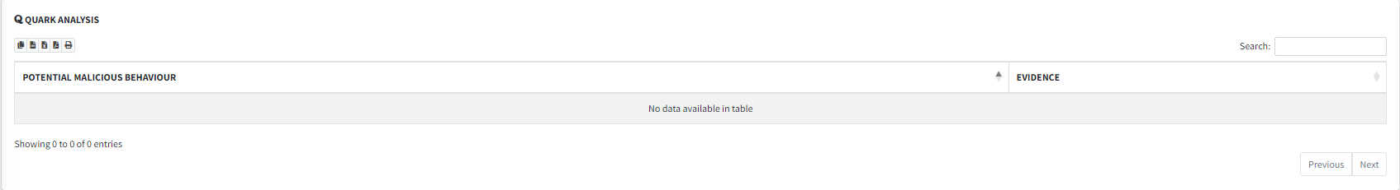
Malware Analysis - Quark Analysis
Quark-Engine is indeed a powerful Android analysis framework designed to delve into APK and DEX files to uncover potential threats and gather intelligence regarding malicious activities. When integrated into MobSF, Quark-Engine enhances the platform’s capabilities by providing advanced analysis features. It consists of two fields ”Potential Malicious Behavior” and ”Evidence” from which details about the malicious behaviors can be known.

Slide 20
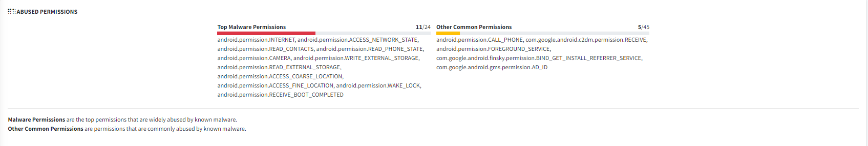
Malware Analysis - Abused Permissions
In MobSF, the "Abused Permission" section distinguishes between permissions commonly utilized by malware for malicious purposes and those frequently requested by legitimate apps but could pose security or privacy risks if misused. This categorization aids users in swiftly recognizing potential security concerns related to permissions requested by Android applications.

Slide 21
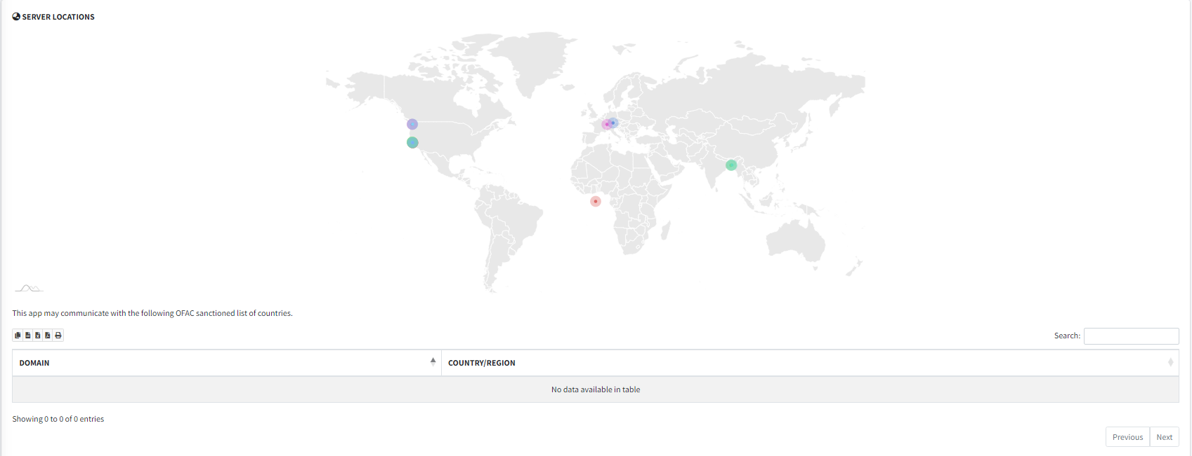
Malware Analysis - Server Locations
Server Locations denote where the servers used in this app resides. The domain sanction provides OFAC sanctioned list of countries with which this app may communicate.

Slide 22
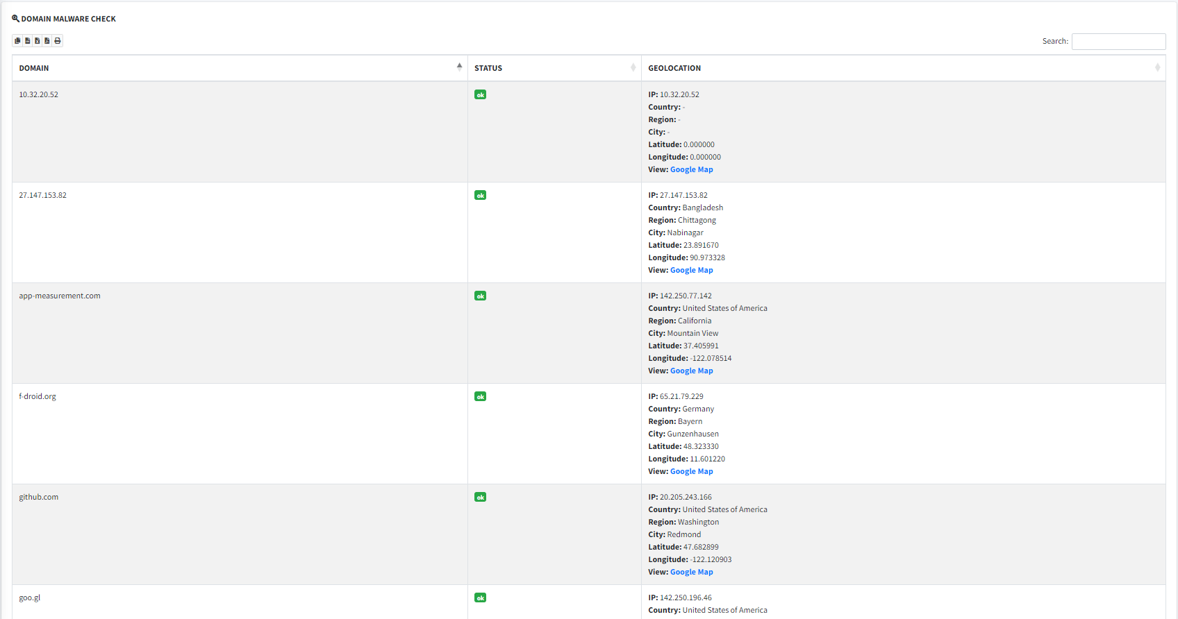
Malware Analysis - Domain Malware Check
The Domain Malware Check feature in MobSF extracts domains from the binary and cross-references them against a database of known malicious or suspicious domains and IPs. Geolocation data for identified domains is retrieved, potentially visualized on platforms like Google Maps to show associated geographical locations. This provides a thorough assessment of domains, helping users identify security threats and understand the geographic distribution of associated IP addresses.

Slide 23
Reconnaissance
Url : MobSF will list all URLs extracted from various parts of the application’s source code, including manifest files, Java code, native code, resources, JavaScript, and HTML files
Firebase DB : MobSF will also extract all the firebase database url from the app and it also performs an additional check to see if the database is exposed to the internet
Emails : MobSF shows all the email ids used in the code along with their corresponding file location in this section
Possible hard coded secrets
Hardcoded strings

Slide 24
Dynamic Analysis
Dynamic analysis involves inspecting the behavior of a program or system while it's running, typically to understand its runtime characteristics, such as memory usage, network activity, and API calls, aiding in security assessments, debugging, and performance optimization.

Slide 25
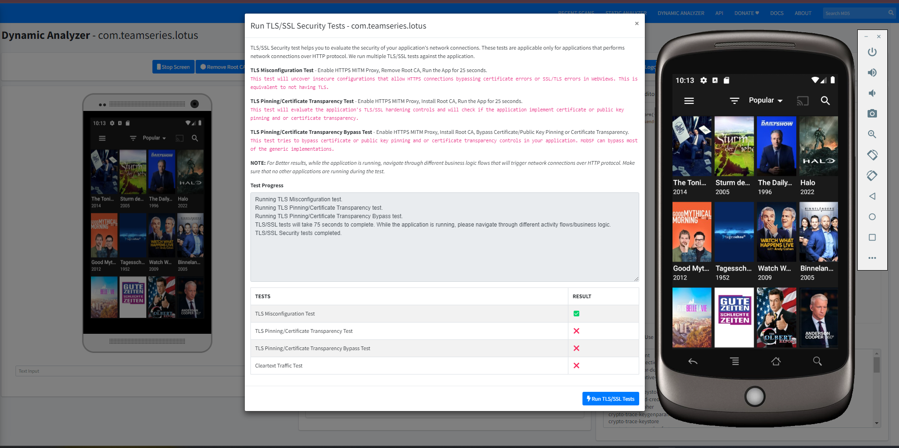
TLS/SSL Testing
A TLS/SSL Security Tester evaluates the configuration and implementation of TLS/SSL protocols on servers or applications. It inspects protocol versions, cipher suites, and certificate validity to identify vulnerabilities.

Slide 26
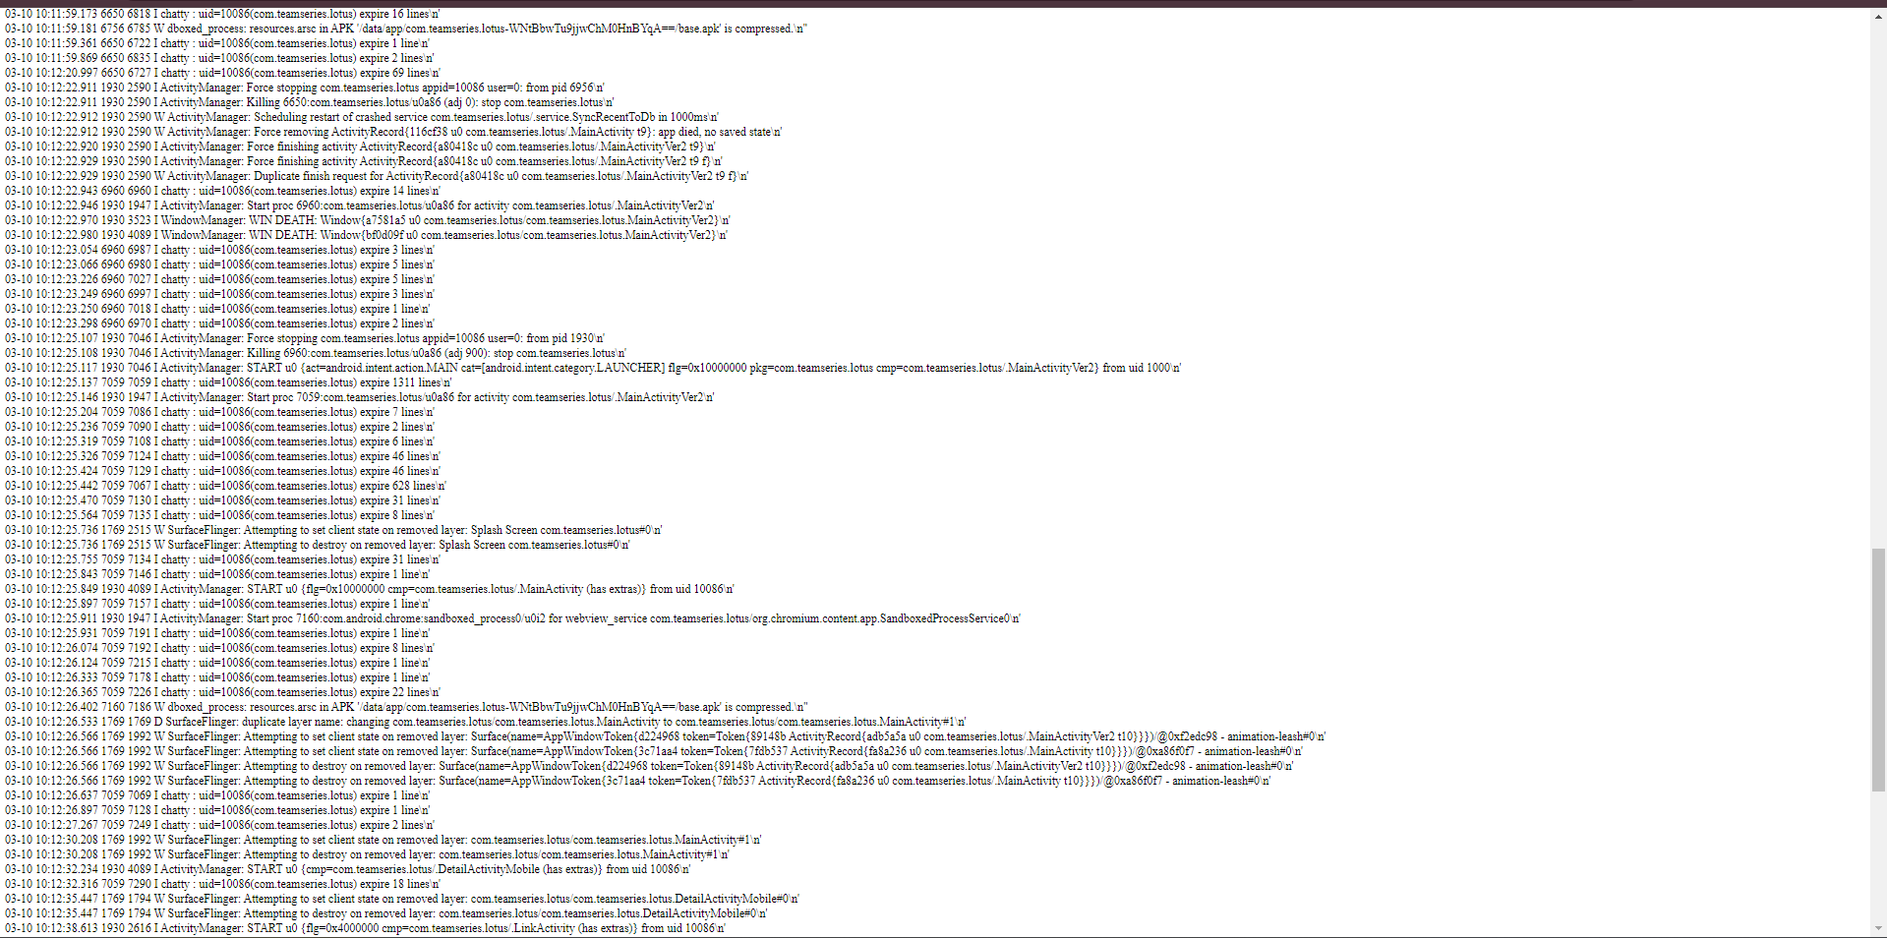
LogCat Stream
The LogCat Stream feature opens a new window to display the live logcat stream of the mobile application. Logcat is a system log provided by Android devices that contains messages from various sources, including system processes, apps, and the Android operating system itself. By showing the logcat stream of the app, analysts can monitor real-time messages and events generated by the application during its execution. This visibility allows for the detection of errors, warnings, debug information, and other relevant events, facilitating troubleshooting, debugging, and security analysis of the application.

Slide 27
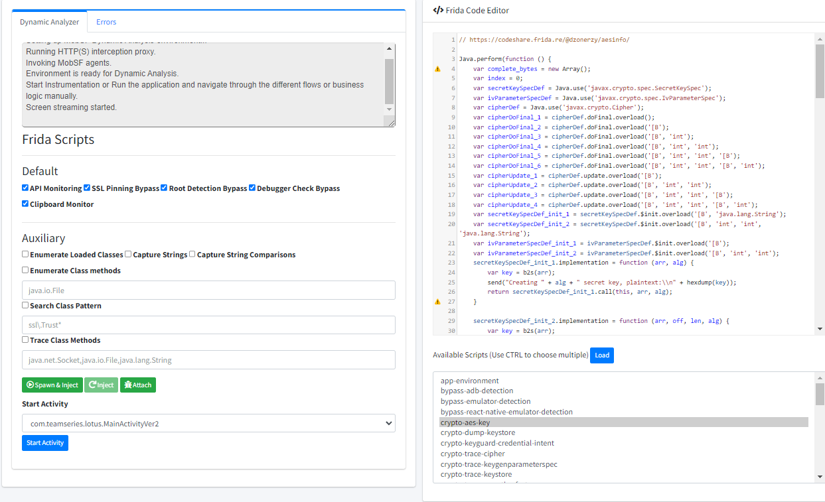
Frida Code Editor
The Frida Code Editor feature in MobSF enables users to craft and upload custom Frida scripts for application analysis. This editor provides a dedicated space to write, modify, and debug scripts tailored to specific testing objectives.

Slide 28
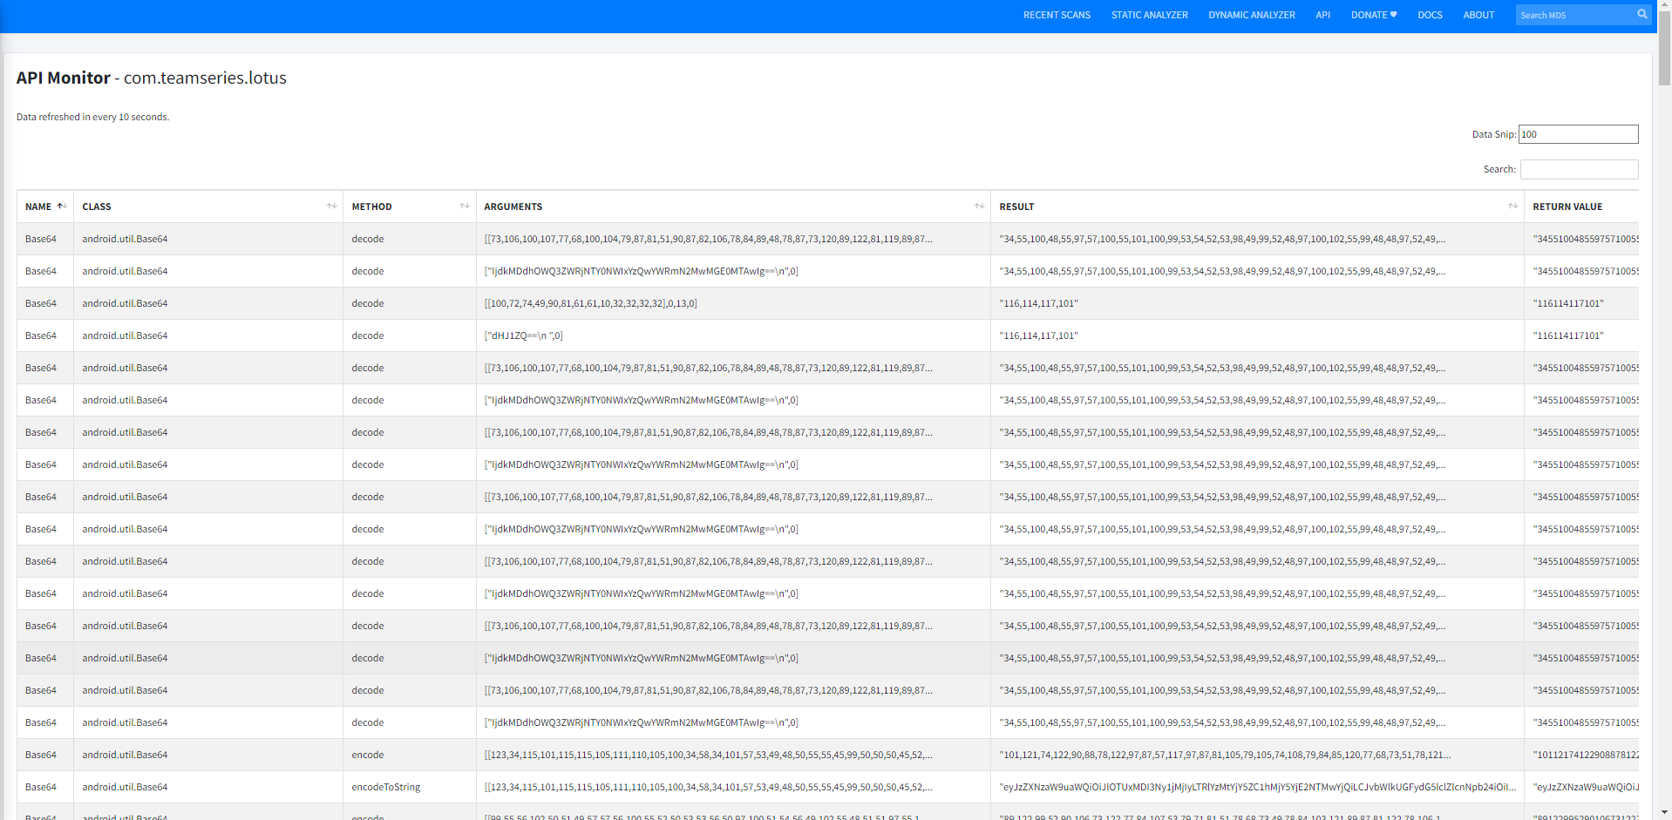
Live API Monitor
Monitors different apis called while the app is running.

Slide 29
Frida API Monitor
Combine Frida dynamic instrumentation with MOBSF for enhanced mobile application security analysis by injecting Frida scripts to monitor API calls at runtime.
This is done by analysing the various classes and objects created and passed during the app’s lifecycle, and detecting strings and string comparisons in while the user manually goes through various flows of the app’s business logic.

Slide 30
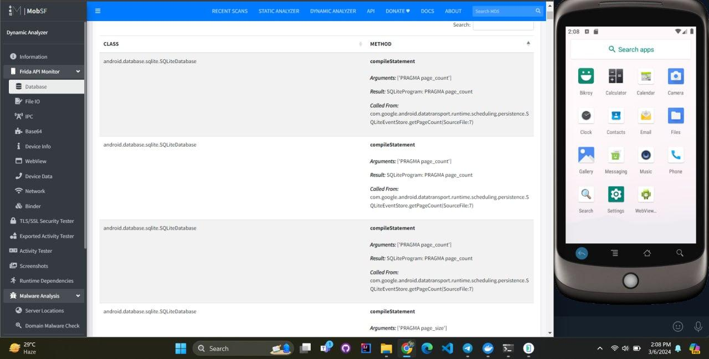
Database
Shows method that communicate with the database.

Slide 31
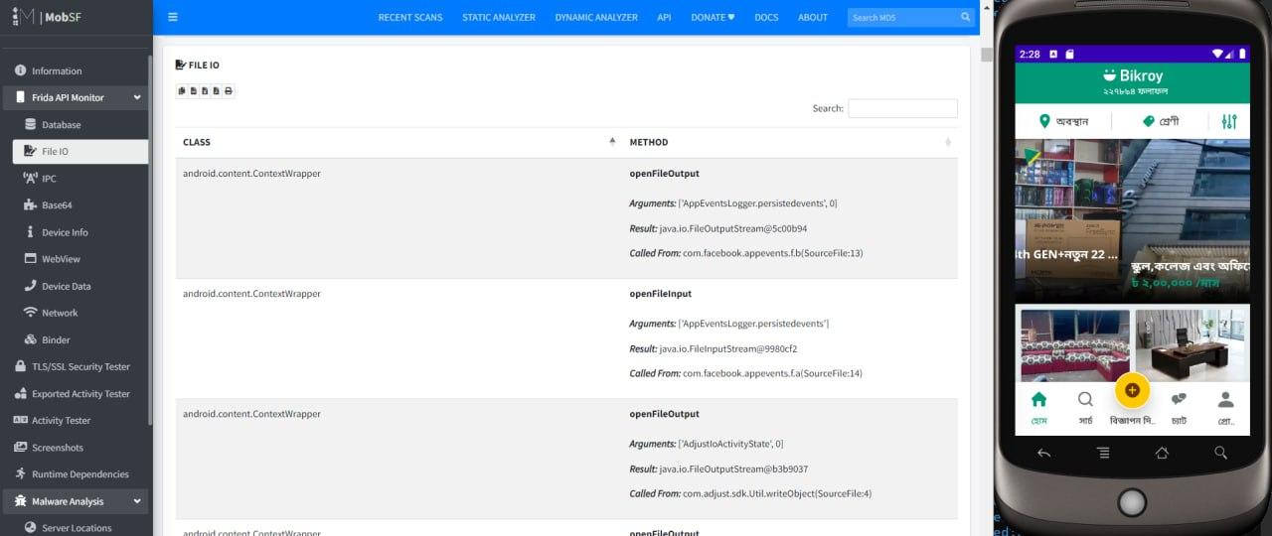
File Io
Monitors and analyzes file operations performed by a program or system during runtime, which includes reading from and writing to files.

Slide 32
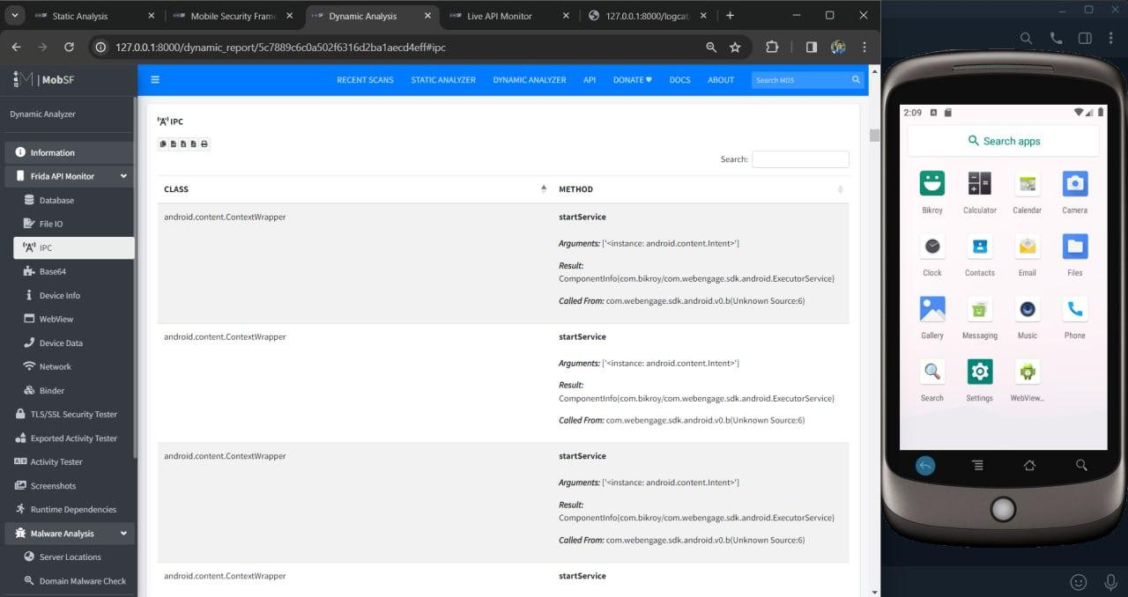
IPC
Inter-Process Communication (IPC) involves monitoring and analyzing the communication channels established between different processes or components of a system during runtime.

Slide 33
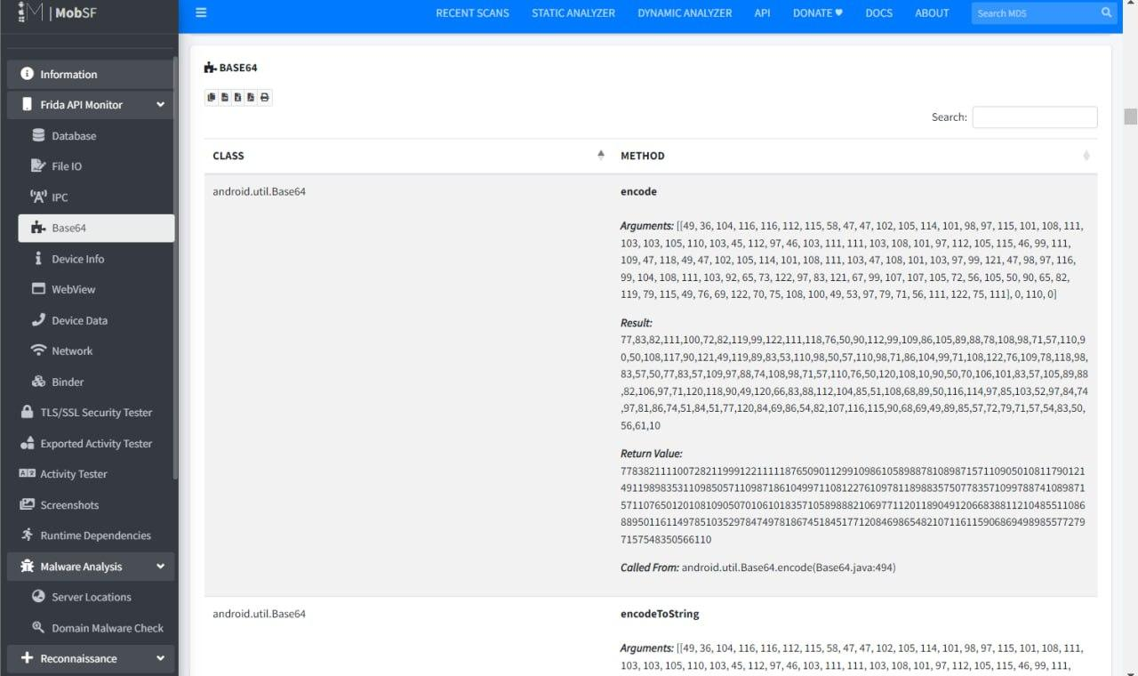
Base64
Base64 decoding involves intercepting and analyzing Base64-encoded data during runtime to understand its content and usage within a program or system.

Slide 34
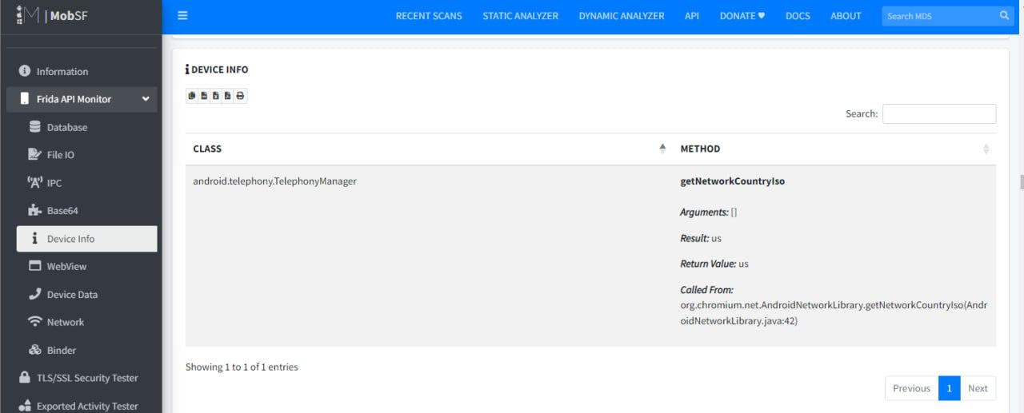
Device Info
Refers to the real-time monitoring and analysis of data related to the device on which a program or application is running.

Slide 35
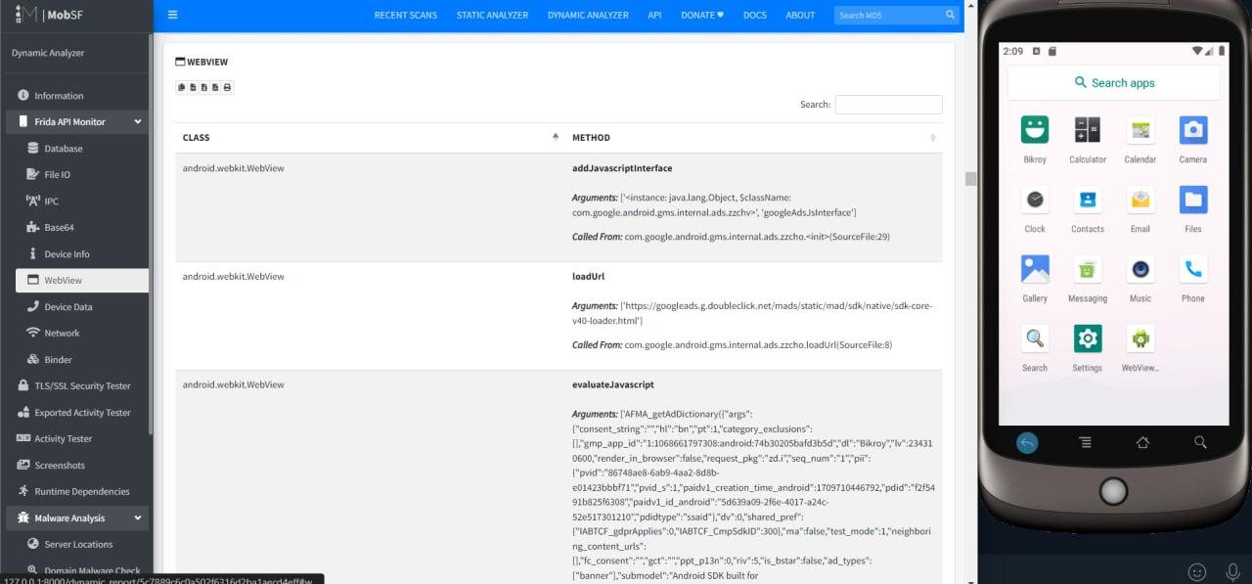
WebView
Refers to the monitoring and analysis of the behavior of WebView components within mobile applications or web browsers during runtime. This involves inspecting the network requests, JavaScript execution etc.

Slide 36
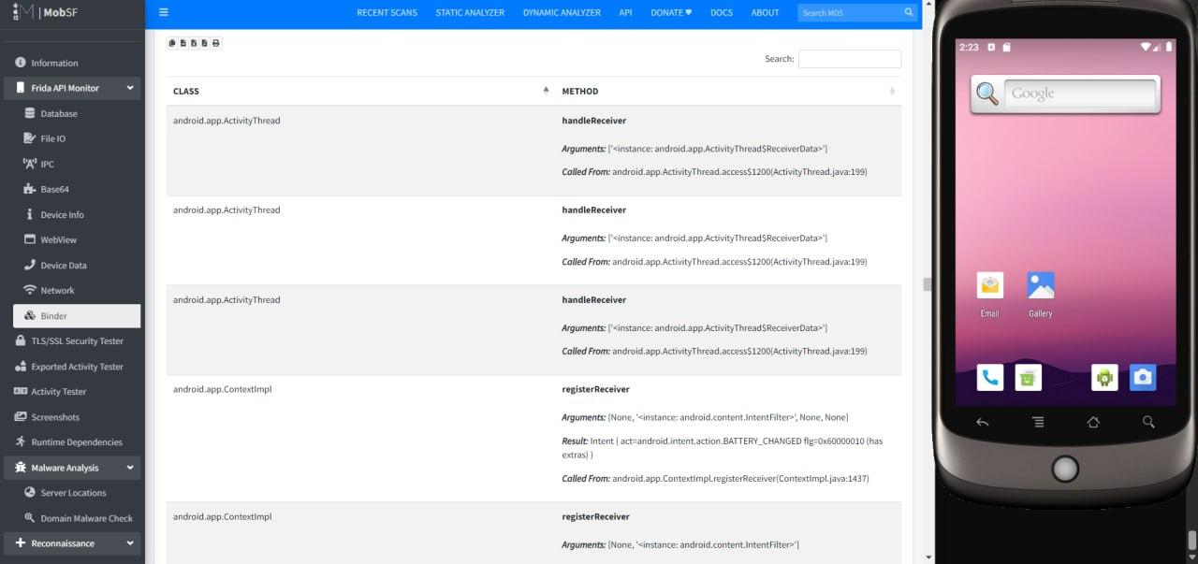
Binder
Binder dynamic analysis involves monitoring and analyzing the inter-process communication (IPC) mechanisms used in Android systems via the Binder framework, aiming to understand communication channels between Android components, detect security vulnerabilities, like privilege escalation and ensure secure data exchange.

Slide 37
TLS/SSL testing:
Look for any warnings or vulnerabilities related to SSL/TLS configurations. This might include issues such as the use of misconfigurations, expired certificates, or improper certificate validation.

Slide 38
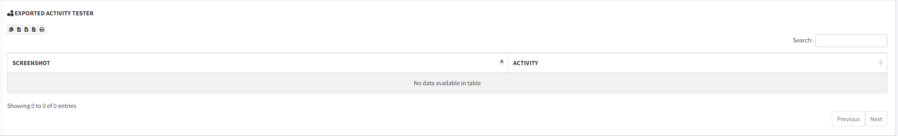
Exported Activity Tester
Tests exported activities within the application.

Slide 39
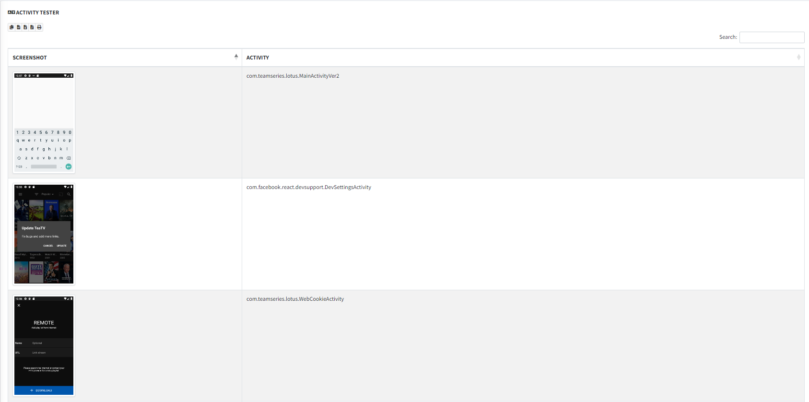
Activity tester
Tracks different activities while running application.

Slide 40
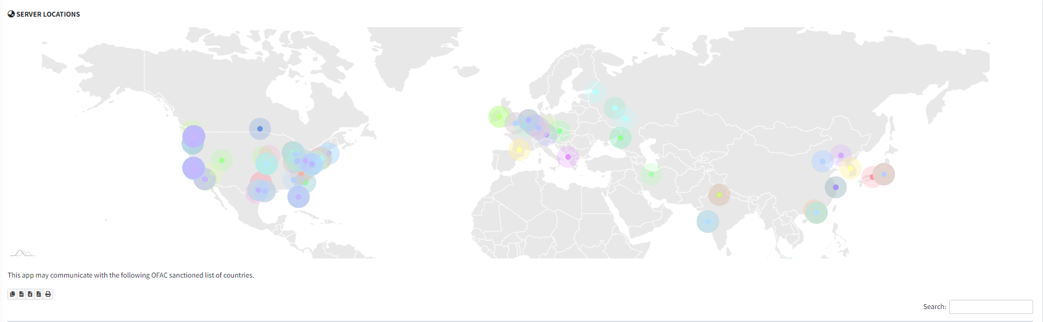
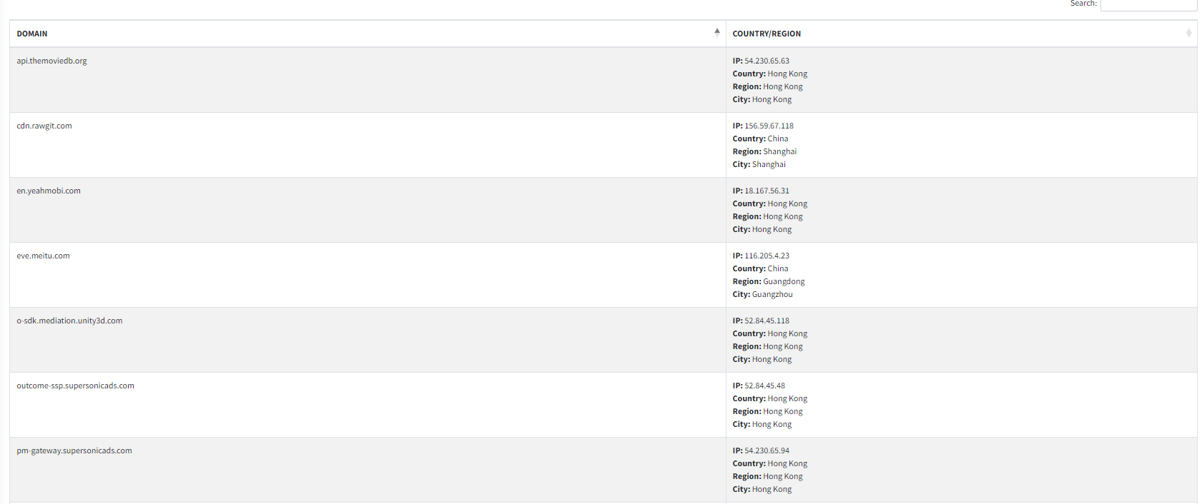
Malware Analysis - Server Locations
Contains servers accessed by the application during runtime.

Slide 41
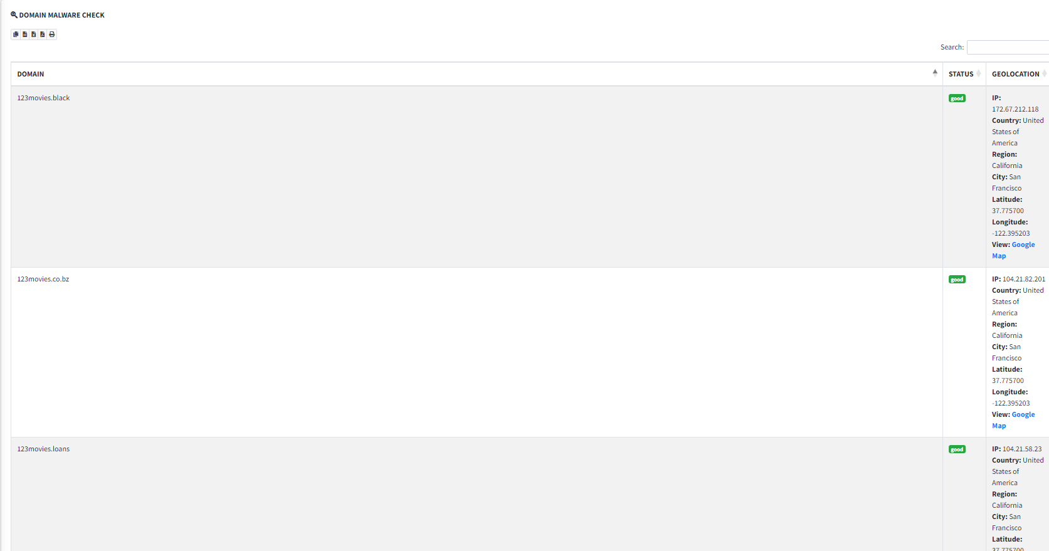
Malware Analysis - Domain Malware Check
Domain Malware Check is a feature within MobSF's dynamic analysis toolkit designed to inspect domains accessed by the mobile application for potential malware or malicious activity. During runtime, MobSF scrutinizes the URLs or domains contacted by the app, cross-referencing them with known malware databases and blacklists. This process helps identify suspicious domains associated with malware distribution, phishing attempts, or other malicious activities.

Slide 42
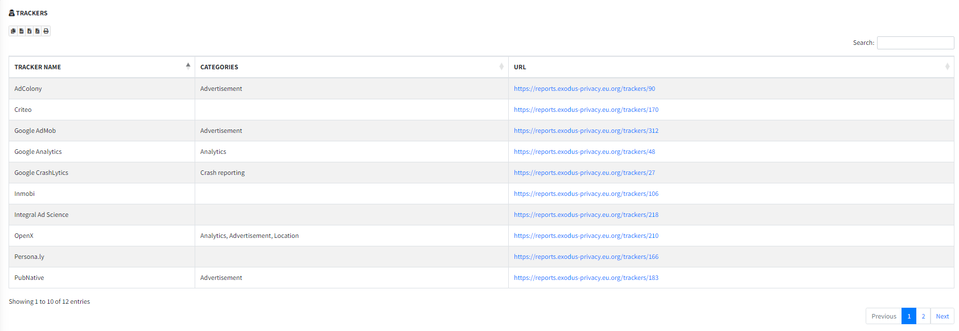
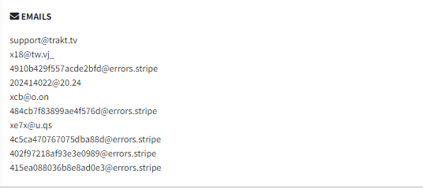
Reconnaissance
Contains clipboard dump, urls used throughout the app, processes that are tracking the application, emails are shown here.

Slide 43
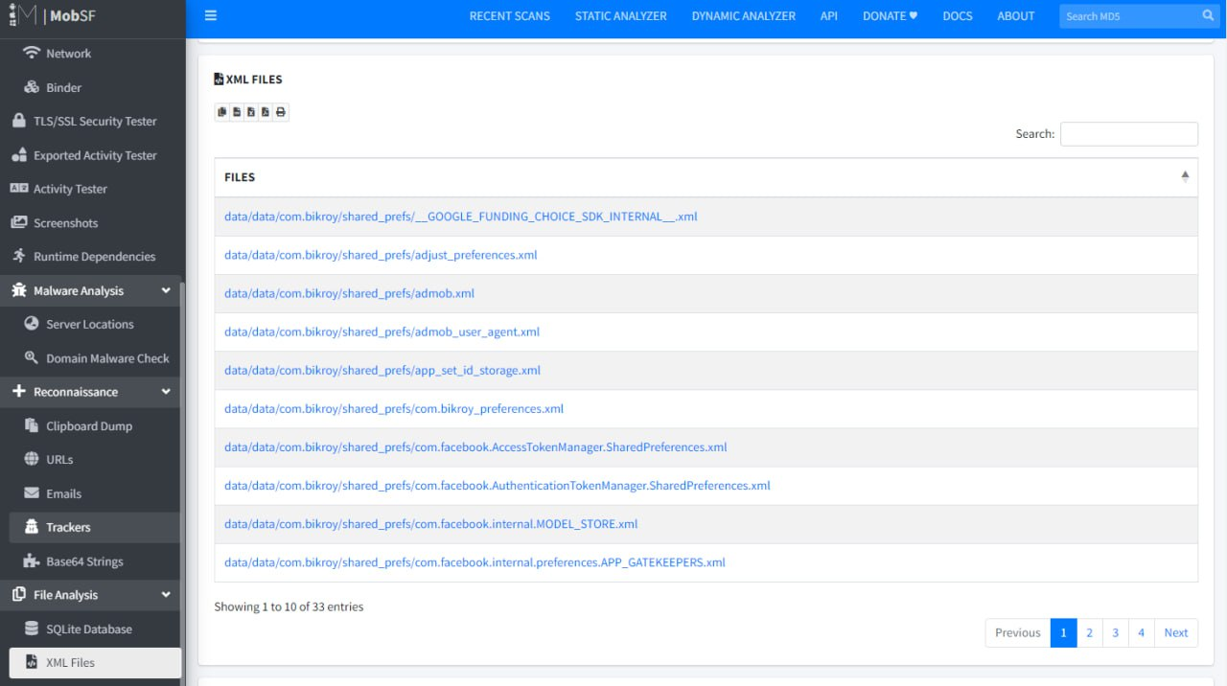
File Analysis - SQLite Files
SQLite databases in mobile apps undergo scrutiny. This involves analyzing the database schema, extracting stored data, and assessing data manipulation. Examining how the app interacts with SQLite reveals its functionality and security measures, such as encryption and access controls.

Slide 44
File Analysis - XML Files
Inspects XML-based data transmission, configuration files, or dynamic content loading to identify potential security vulnerabilities, such as XML injection or improper data validation. Dynamic analysis of XML files in MOBSF helps understand how mobile applications handle XML data, detect vulnerabilities, and ensure secure XML processing.

Slide 45
THANK YOU

